Slide 1
Visual Interface Design Visual interface design interface design guidelines Psychological principles information design visualization

Slide 2
Introduction
The design of the interface that mediates the interaction of people with devices is a crucial characteristic of the overall interaction design.
This is often referred to as the user interface (UI) and it consists of everything in the system that people come into contact with whether that is physically, perceptually or conceptually.
Physically people interact with systems in many different ways such as by pressing buttons, touching a screen, moving a mouse over a table so that it moves a cursor over the screen, clicking a mouse button, rolling your thumb over a scroll wheel.
Perceptually people interact with a system though what they can see, hear and touch. The visual aspects of interface design concern designing so that people will see and notice things on a screen.
Conceptually people interact with systems and devices through knowing what they can do and how knowing how they can do it.

Slide 3
The UI skill
Putting these three aspects together is the skill of interface designer
Interface design is about creating an experience that enables people to make the best use of the system being designed.
Physical, perceptual and conceptual design get woven together into the experiences of people.

Slide 4
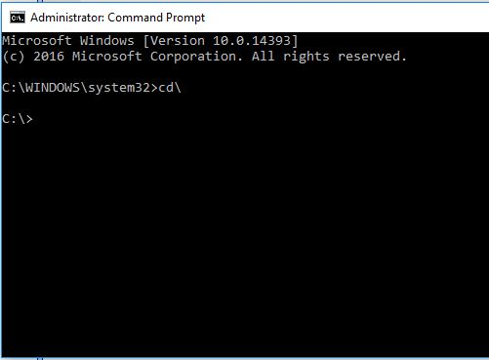
Command Languages
The vast majority of personal computers and many small devices have graphical user interfaces (GUIs), however, many computers are used as Web, network or database servers and a number of these are UNIX-based.
Command language is simply a set of words with an associated syntax
Command languages have been criticized because people have to recall the name of a particular command and to recall the syntax of the command.

Slide 5
Graphical User Interfaces
Graphical user interfaces (GUIs), which are found on every personal computer, on smart phones, on touch screen displays and so on, have had an interesting though brief history.
The Microsoft range of Windows GUIs were influenced by those on the Macintosh, which in turn was inspired by work at Xerox PARC, During the 1980s and 1990s a number of different designs of GUIs were produced, but gradually Windows and Apple Macintosh came to dominate the GUI operating system market.

Slide 6
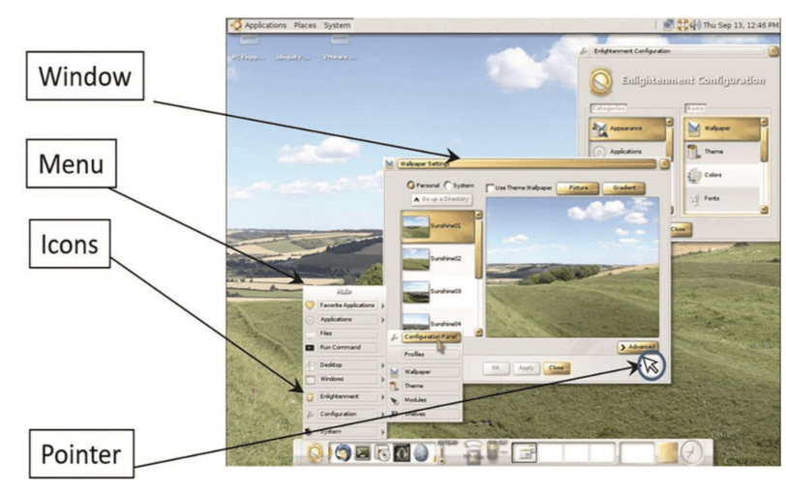
WIMPs
WIMP stands for windows, icons, menu and pointer.
A window is a means of sharing a device’s graphical display resources among multiple applications at the same time.
An icon is an image or symbol used to represent a file, folder, application or device, such as a printer.
A menu is a list of commands or options from which one can choose.
The last component is pointing device of which the mouse is the most widespread, but fingers are also used as is the stylus.
This form of interaction is called direct manipulation because we directly manipulate the on-screen objects as opposed to issuing commands through a command based interface.

Slide 7
Windows
Windows allow a workstation’s screen to be divided into areas which act like separate input and output channels that can be placed under the control of different applications.
This allows people to see the output of several processes at the same time and to choose which one will receive input by selecting its window, using a pointing device such by clicking on it with a mouse, or touching a touch screen.
This is referred to as changing the focus.

Slide 8
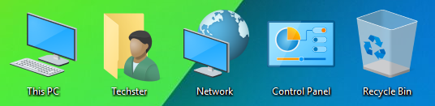
Icons
Icons are used to represent features and functions on everything from software applications, DVD players and public information kiosks to clothing.
Icons are generally regarded as being useful in helping people to recognize which feature they need to access.
Icons make use of three principle types of representation - metaphor, direct mapping and convention.
Metaphor relies on people transferring knowledge from one domain and applying to another.
The use of direct mapping involves creating a more or less direct image of what the icon is intended to represent.
Finally convention refers to a more or less arbitrary design of an icon in the first instance, which has become accepted as standing for what is intended over time.

Slide 9
Horton’s icon checklist
William Horton’s checklist (1991) designed to help the icon designer avoid common mistakes. his top-level headings are here, with a sample question for each issue.
Understandable. Does the image spontaneously suggest the intended concept to the viewer?
Familiar. Are the objects in the icon ones familiar to the user?
Unambiguous. Are additional cues (label, other icons documentation) available to resolve any ambiguity?
Memorable. Where possible, does the icon feature concrete objects in action? Are actions shown as operations on concrete objects?
Informative. Why is the concept important?
Few. Is the number of arbitrary symbols less than 20?
Distinct. Is every icon distinct from all others?
Attractive. Does the image use smooth edges and lines?
Legible. Have you tested all combinations of colour and size in which the icon will be displayed?
Compact. Is every object, every line, every pixel in then icon necessary?
Coherent. Is it clear where one icon ends and another begins?
Extensible. Can I draw the image smaller? Will users still recognize it?

Slide 10
Menus
When creating menus, commands should be grouped into menu topics, which are a list of menu items.
When a command or option (menu item) is selected from the list, an action is performed. Menus are also used extensively on web sites to structure information and to provide the main method of navigation of the site’s content.
Hierarchical menus: various options are arranged under a top-level topic (filter) and in turn have series of sub-menus.
Hierarchical menus are also called cascading menus. In a this menu, the sub-menu appears to cascade out when a choice is made from the higher-level menu.
A pop-up menu is distinguished from a standard menu in that it is not attached to a menu bar in a fixed location.
Also in this case it is also a contextual menu. The make-up of contextual menus varies according to the context from which they are invoked. If a file is selected, the contextual menu offers file options. If instead a folder is selected, folder options are displayed.

Slide 11
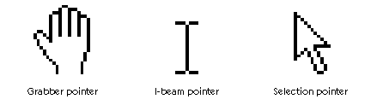
Pointers
The final part of the WIMP interface is the pointer.
The most common is the mouse, but joysticks are also common, for example in game controllers.
On mobile phones and PDAs, a stylus is often provided as the pointer and on touchscreen system the finger used.
Remote pointers include the Wii wand and other infra-red pointers, for example for doing presentations.
The arrival of multitouch surfaces has enabled a wide range of gestures to be recognized in addition to a simple point and select operation.
Arrow vs. I-beam

Slide 12
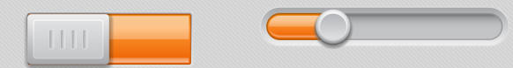
Interface design guidelines: widgets
Radio buttons Use a series of radio buttons to allow the user make exclusive choices.
Checkboxes - Checkboxes should be used to display individual settings that can be switched (checked) on and off.
Toolbars - A toolbar is a collection of buttons grouped according to function (in this respect they are conceptually identical to menus). Passing the mouse pointer over an icon will usually trigger the associated ‘tool tip’ which is a short textual label describing the function of the button.
List boxes List boxes take a variety of forms and within these forms they offer different ways of viewing the contents – as lists (with more or less detail), as icons or as thumbnails (little pictures of the files’ contents
Sliders - A slider is a widget which can return analogue values. Sliders are ideally suited to controlling or setting such things as volume or brightness or scrolling through a document.

Slide 13
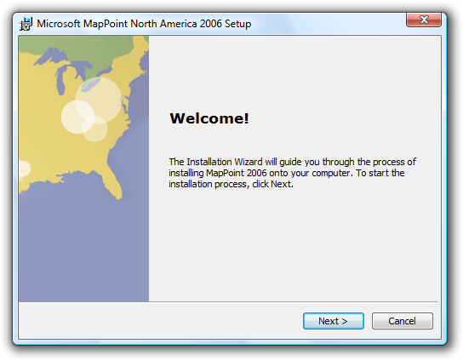
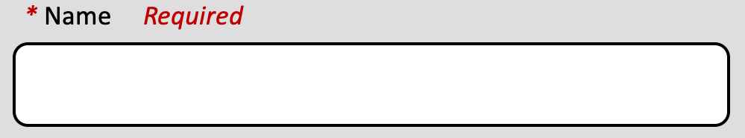
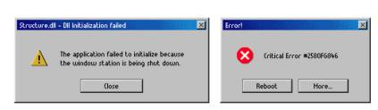
Form filling is an interface style that is particularly popular with Web applications. Form fill interfaces are used to gather information such as name and address. The individual boxes are called fields and are frequently marked with an asterisk (*) to indicate that an entry is mandatory.
Form fill interfaces are best used when structured information is required. It can sometimes be automatically updated from a set of structured data stored on PC.
Wizard is the name given to a style of interaction that leads people step by step through a series of questions and answers, picklists and other kinds of widgets to achieve a task.
Alerts: Notifications, Obtrusive/unobtrusive

Slide 14
Interface Design Guidelines
Cooper (2007) argues that visual interface design is a central component of interaction design as it combines graphic design, industrial design and visual information design
Designers need to know about graphic design such as what shape, size colour, orientation and texture screen objects should be.
Designs should have a clear and consistent style
The design language will be learnt and adopted by people, so they will expect things that look the same to behave the same and, conversely if things behave different make sure they look different.

Slide 15
Principles from memory and attention
Short-term (or working) memory
Chunking
Time limitations
Recall and recognition
Designing for memory
Designing with colour (next slide)

Slide 16
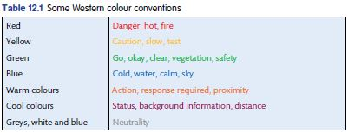
Designing with colour
Aaron Marcus’s excellent book Graphic Design for Electronic Documents and User Interfaces ( Marcus, 1992 ) provides the following rules:
Rule 1: Use a maximum of 5 +/- 2 colours.
Rule 2: Use foveal (central) and peripheral colours appropriately.
Rule 3.\: Use a colour area that exhibits a minimum shift in colour and/or size if the colour area changes in size.
Rule 4: Do not use simultaneous high-chroma, spectral colours.
Rule 5: Use familiar, consistent colour codings with appropriate references.
Colour connotations can vary dramatically even within a culture.
Marcus notes that the colour blue in the United States is interpreted different by different groups – for healthcare professionals it is taken to indicate death, for accountants it means reliability or corporateness (think of the ‘Big Blue’ – IBM).

Slide 17
Error avoidance design guidelines
Use knowledge both in the world and in the head in order to promote a good conceptual model of the system; this requires consistency of mapping between the designer’s model, the system model and the user’s model.
Simplify the structure of tasks so as to minimize the load upon vulnerable cognitive processes such as working memory, planning or problem solving.
Make both, execution & the evaluation, sides of an action visible. Visibility in regard to the former allows users to know what is possible & how things should be done.
Exploit natural mappings between intentions & possible actions, between actions and their effects on the system, between the actual system state and what is perceivable, & between the system state and the needs, intentions & expectations of the user.
Exploit the power of constraints, both natural and artificial. Constraints guide people to the next appropriate action or decision.
Design for errors. Assume that they will happen, then plan for error recovery. Try to make it easy to reverse operations and hard to carry out non-reversible ones.
When all else fails, standardize actions, outcomes, layouts, displays, etc. The disadvantages of less than perfect standardization are often compensated for by the increased ease of use. But standardization for its own sake is only a last resort. The earlier principles should always be applied first.

Slide 18
Error message design guidelines
Take care with the wording and presentation of alerts and error messages.
Avoid using threatening or alarming language in messages (e.g. fatal error, run aborted, kill job, catastrophic error).
Do not use double negatives as they can be ambiguous.
Use specific, constructive words in error messages (e.g. avoid general messages such as ‘invalid entry’ and use specifics such as ‘please enter your name’).
Make the system ‘take the blame’ for errors (e.g. ‘illegal command’ versus ‘unrecognized command’).
DO NOT USE ALL UPPERCASE LETTERS as it looks like you are shouting – instead, use a mixture of uppercase and lowercase.
Use attention grabbing techniques cautiously (e.g. avoid over-using ‘blinks’ on Web pages, flashing messages, ‘you have mail’, bold colours, etc.).
Do not use more than four different font sizes per screen.
Do not over-use audio or video.
Use colours appropriately and make use of expectations (e.g. red = danger, green = ok).

Slide 19
Information Design
Information design is concerned with the presentation of large amounts of information in the most informative way.
General design principles of avoiding clutter, avoiding excessive animations and avoiding clashing colours also help make displays understandable.
Card (2008) provides a detailed taxonomy of the various types of visualization and provides details on different types of data that designers can deal with. He also discusses the different visual forms that can be used to represent data.
When developing a scheme of information design in a given context, designers should realize that they are developing visual ‘languages’. The visual language of information design is an important part of these. Designers will imbue colours, shapes and layouts with meanings that people have to come to understand.

Slide 20
Interactive visualizations
Card (2008) argues that visualization is concerned with ‘amplifying cognition’. It achieves this through
increasing the memory and processing resources available to people,
reducing the search for information,
helping people to detect patterns in the data,
helping people to draw inferences (idea) from the data,
encoding data in an interactive medium

